Slide 1
Unit Tests & Mocking in Java
Alex Silvesan
March 27, 2023

Slide 2


Our solutions
Order management, execution management, smart order routing
and a suite of algorithms to meet all your agency or principal risk trading requirements.
Fully managed FIX services or the FIX engines, testing, certification and monitoring tools you need to build your own buyside-to-sellside connectivity solution.
An automation framework that can be applied to both agency and principal trading solutions to make your trade lifecycle as efficient as possible.
TRADE
CONNECT
AUTOMATE
Itiviti provides the most comprehensive trading and connectivity solutions in the capital markets.
Combined with an advanced automation framework, our products provide the flexibility and breadth of functionality needed to match any trading style across equities, derivatives, foreign exchange (FX) and fixed income.

Slide 3
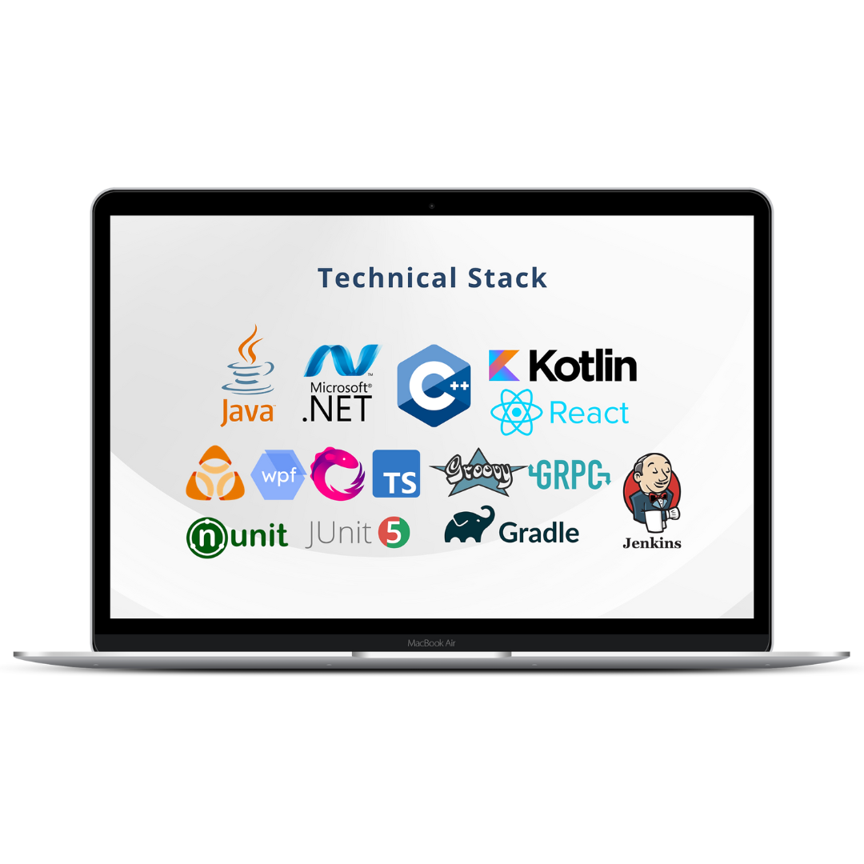
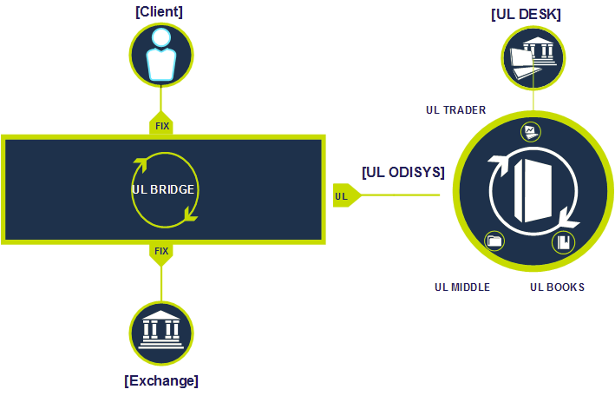
How we do it

Slide 4
Table of contents
Automated software testing
Unit tests
Mocking

Slide 5
Automated software testing
WhY IS SOFTWARE Testing IMportant?

Slide 6
Automated software testing
WhY IS SOFTWARE Testing IMportant?
ensure the code is doing what it's supposed to
prevent bugs or at least find them early
spot regressions
makes refactoring safer and quicker

Slide 7
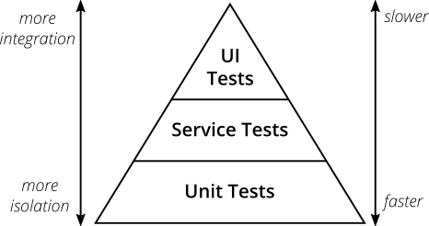
Automated software testing
AUTOMATED TESTING PYRAMID [1]

Slide 8
Unit tests
reliable & consistent
Unit tests should have the same result regardless of the machine they run on
run fast
We should we able to run thousands of unit tests in a couple of seconds
isolated from and independent of other unit tests
easy to write & understand

Slide 9
Unit tests
Best practices:
follow given-when-then approach
verify only a single scenario in each test
don’t duplicate (copy/paste) the code you’re testing in the unit tests
keep the test code simple: avoid loops, branching in the test
cleanup potential side effects done by the test
try TestDrivenDevelopment (TDD)
write tests first then write the production code such that all the tests pass

Slide 10
Unit tests
What test cases would you write for a function with the following signature:
int parseInt(String s)

Slide 11
Unit tests
Writing testable CODE

Slide 12
Mocking
When do we USE mockING
It’s all about having all the control and managing complexity
we want to control the data & the object behavior
when interacting with external systems
network, internet, file system, database
when we want to isolate (limit the scope) of what we're testing
unit tests should only test one unit (class), all the dependencies should be controlled (mocked)

Slide 13
Mocking
ADVANCED MOCKING TOPICS
conditional mocking
verifying number of interactions
mocking void methods
intercepting method call arguments
mocking static / final classes and methods => possible with Mockito/PowerMock, but it’s a hint that maybe you need to redesign your code

